Slide 1
Distributed Strategies of Large Language Models
Tingyin Wang, Siqi Chen
April 15, 2025

Slide 2
Content
Research Background and Introduction
Core Distributed Strategies
Practical Applications
Llama 3
DeepSeek-V3
PETALS (Consumer-grade networks)

Slide 3
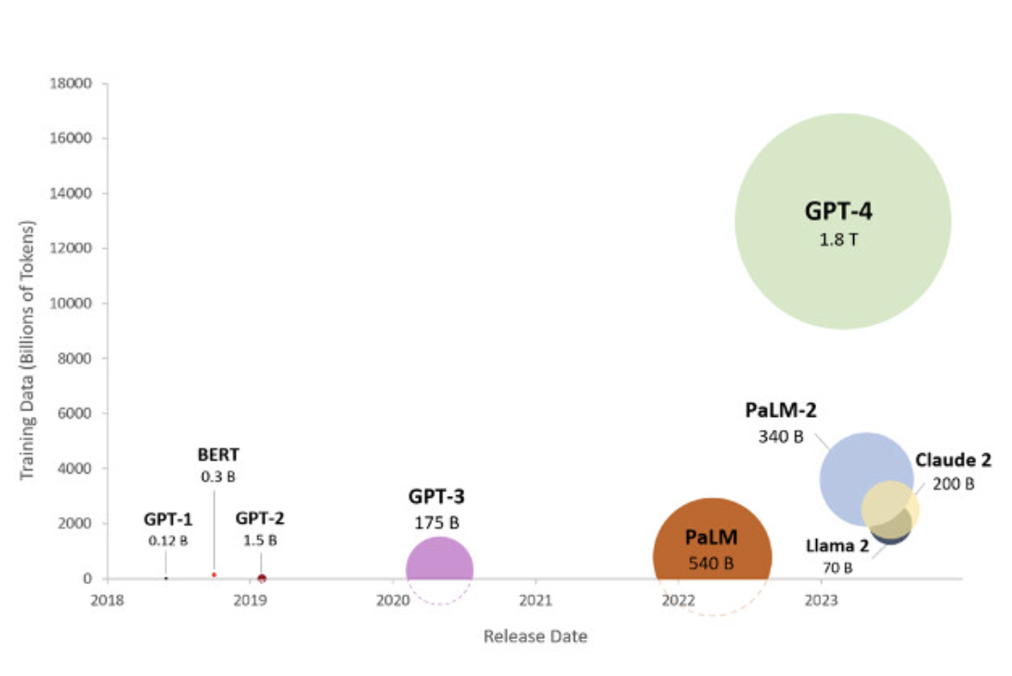
Background
Large Language Models (LLMs) with billions to trillions of parameters demand massive computational resources, due to memory constraints and prolonged training times on single devices.
Ref: A survey of large language models

Slide 4





Why Distributed Strategies Matter
Distributed strategies partition computation and data across multiple GPUs, reducing per-device memory demands and accelerating training.
They enable scalable training on high-performance computing (HPC) systems.

Slide 5
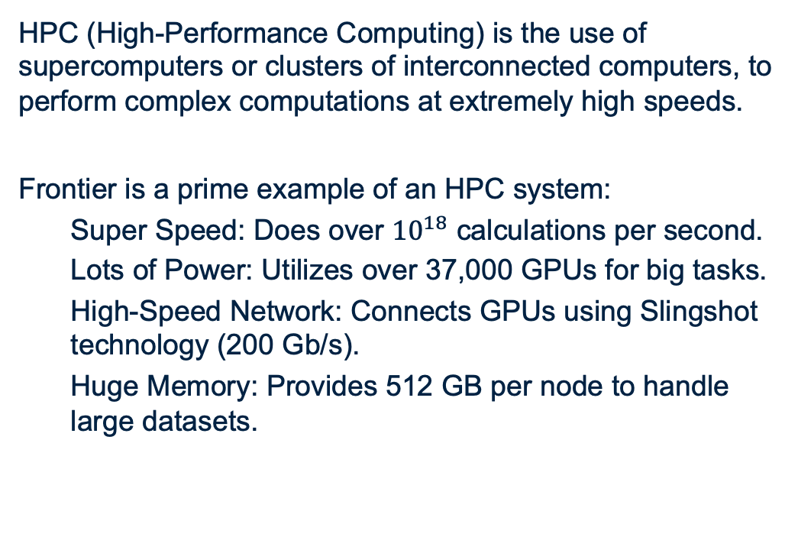
What is Frontier?
HPC (High-Performance Computing) is the use of supercomputers or clusters of interconnected computers, to perform complex computations at extremely high speeds.
Frontier is a prime example of an HPC system:
Super Speed: Does over ${10}^{18}$ calculations per second.
Lots of Power: Utilizes over 37,000 GPUs for big tasks.
High-Speed Network: Connects GPUs using Slingshot technology (200 Gb/s).
Huge Memory: Provides 512 GB per node to handle large datasets.

Slide 6
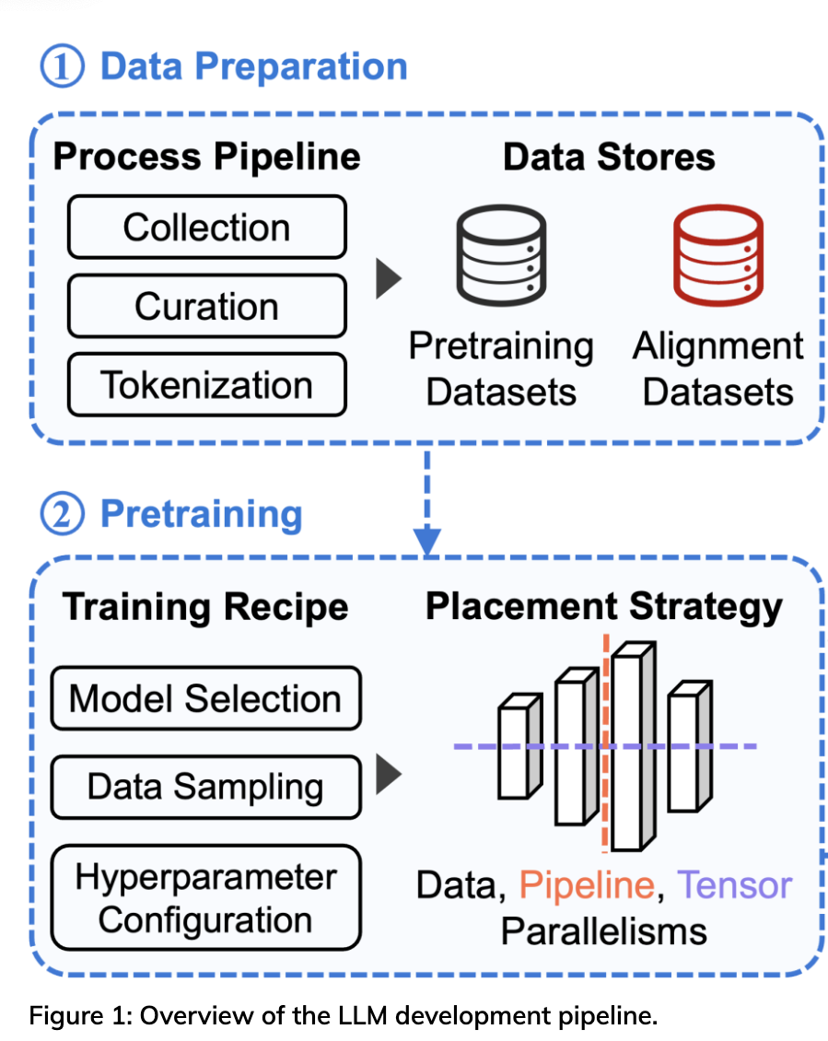
Classification of Distributed Strategies
Distributed Strategies
System design-based
Model feature-based
System design-based: Strategies optimize computation and resource allocation for general models.
Model Feature-based: Strategies leverage specific model architectures.

Slide 7
Classification of distributed strategies
Data parallelism
Distributed Strategies
System design-based (general purpose)
Model parallelism
Pipeline parallelism
Sequence parallelism
long-context tasks, transformers
Model feature based (Architecture-specific)
Expert parallelism
Mixture-of-experts

Slide 8
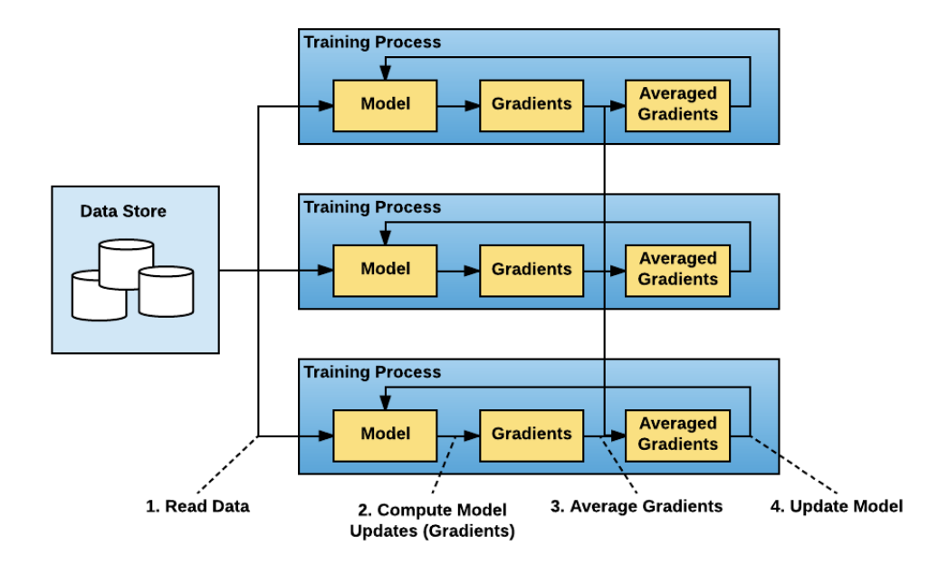
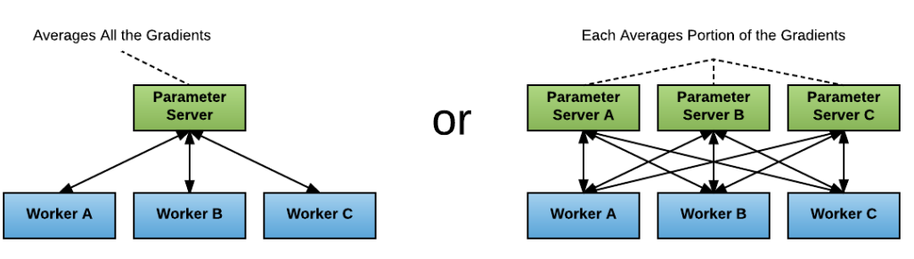
Data parallelism: Vanilla Parallelism
Reference: Horovod: fast and easy distributed deep learning in TensorFlow
Each GPU holds a full model copy and reads a chunk of the data.
Gradients are computed and averaged across GPUs.
The model is updated, and the process repeats.

Slide 9
Parameter settings
To illustrate, we investigate memory allocation and communication volume with the following settings:
Model Parameters: 2-layer Transformer (Embedding + 2 Transformer Layers + Output Layer) with 16,554,768 parameters (33.1 MB, float16)
Data Parameters: Mini-batch size of 32 samples, sequence length of 128, hidden dimension of 512 (Mini-batch size: 8.0 MB, Activation per layer: 2.0 MB).
Scenario: 4 GPUs.

Slide 10
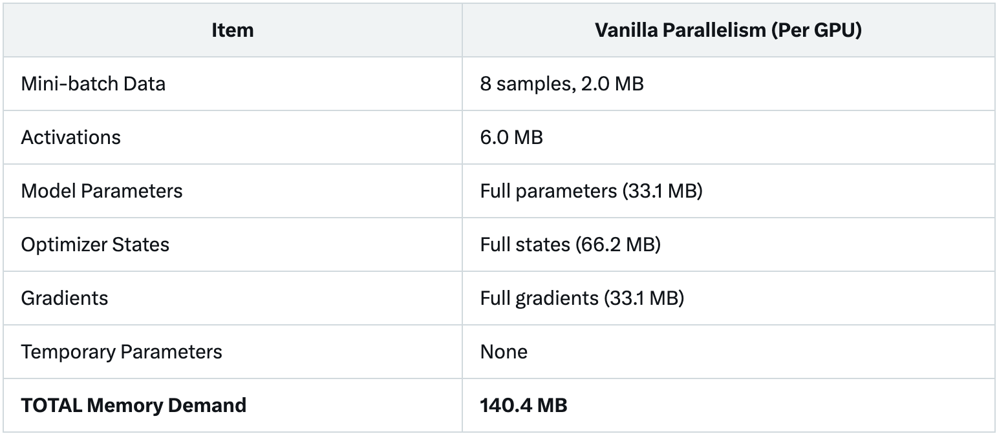
Memory allocation of Vanilla Parallelism
3 layers * 2MB (2 transformer + output)
Memory allocation of vanilla parallelism

Slide 11
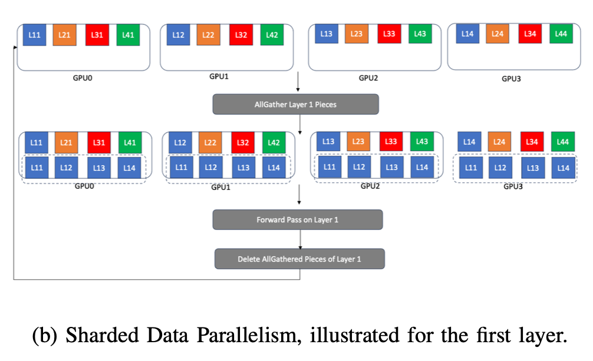
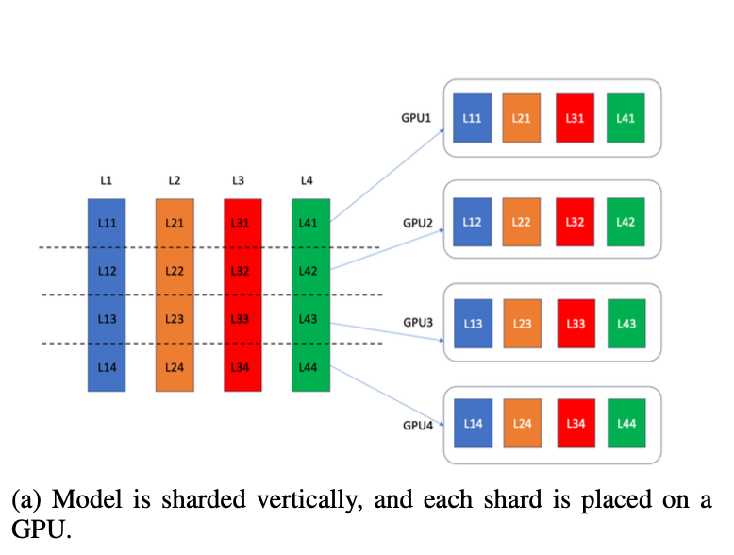
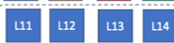
Data parallelism: sharded parallelism
Sharded data parallelism shards model parameters, optimizer states, and gradients and places one partition on each GPU.
is shared
Figure (a), (b) are both from Reference: optimizing distributed training on Frontier for Large Language Model

Slide 12
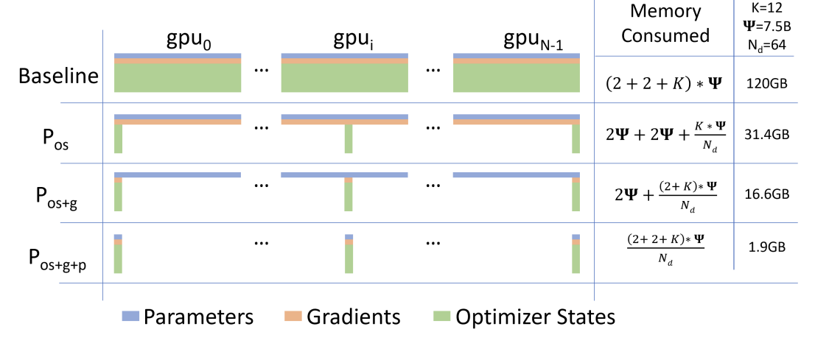
Data parallelism: sharded parallelism
Reference: ZeRO: Memory Optimizations Toward Training Trillion Parameter Models
Optimizer State Partitioning: Distributes optimizer states across GPUs.
Gradient Partitioning: Each GPU stores gradients corresponding to its optimizer state shard.
Parameter Partitioning: Each GPU holds 1/N of the parameters.

Slide 13
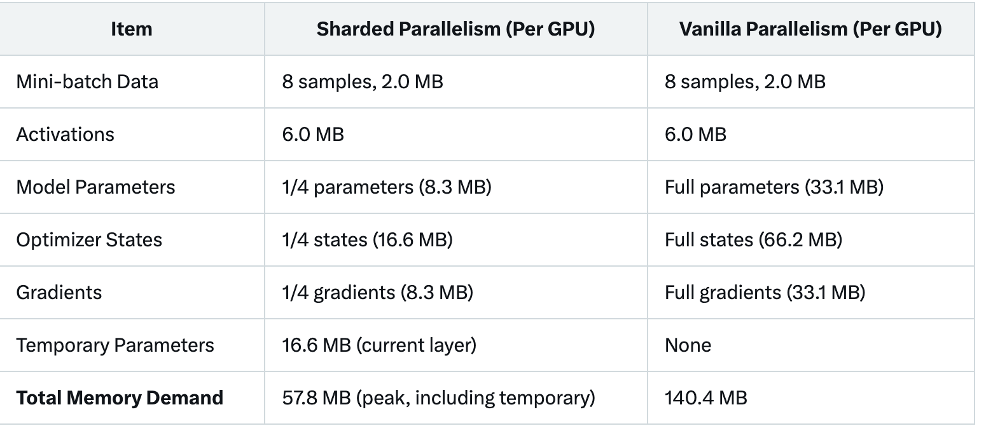
Vanilla Parallelism vs. sharded parallelism
Model parameter: 2-layer Transformer (embedding + 2 transformer + output layer) with 16,554,768 parameters (size 33.1 MB).
Memory Allocation Comparison between Sharded Data Parallelism and Vanilla Parallelism for a Simple Transformer Model (16.5M Parameters, 4 GPUs).

Slide 14
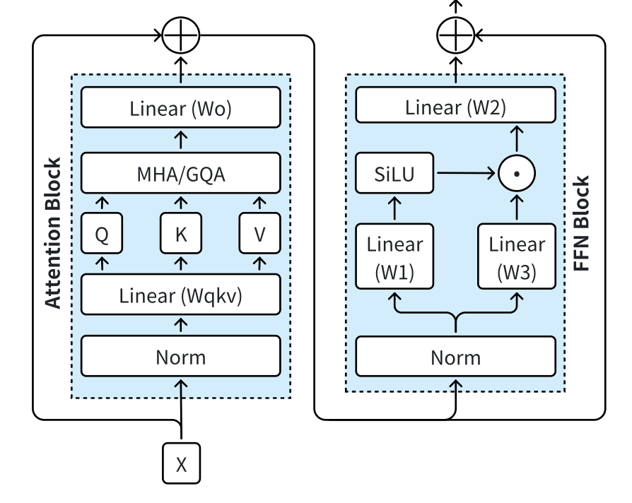
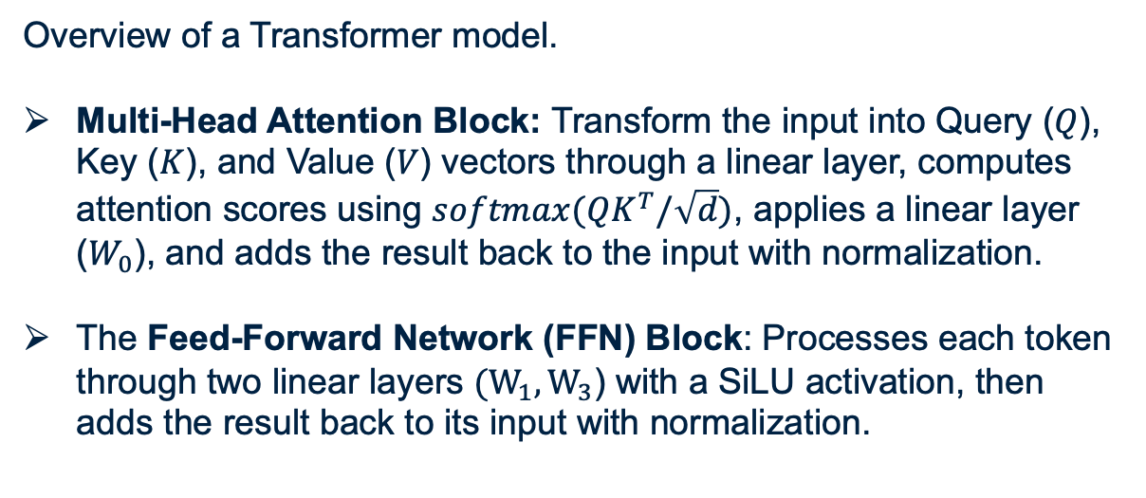
Model parallelism: tensor parallelism
Overview of a Transformer model.
Multi-Head Attention Block: Transform the input into Query ($Q$), Key ($K$), and Value ($V$) vectors through a linear layer, computes attention scores using $softmax(QK^{T}/\sqrt{d})$, applies a linear layer ($W_{0}$), and adds the result back to the input with normalization.
The Feed-Forward Network (FFN) Block: Processes each token through two linear layers $(W_{1}, W_{3}$) with a SiLU activation, then adds the result back to its input with normalization.
Notes:
Review attention机制

Slide 15
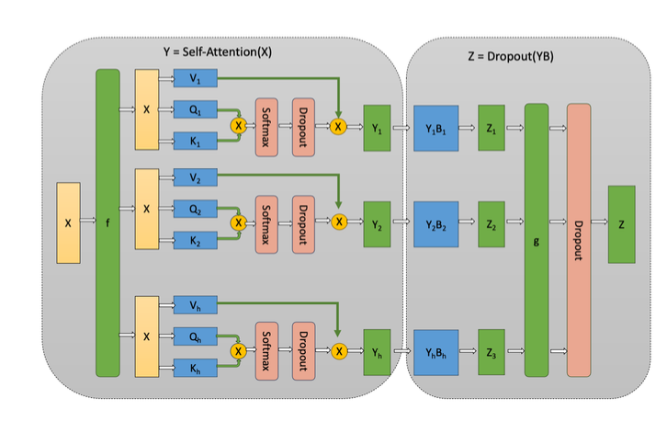
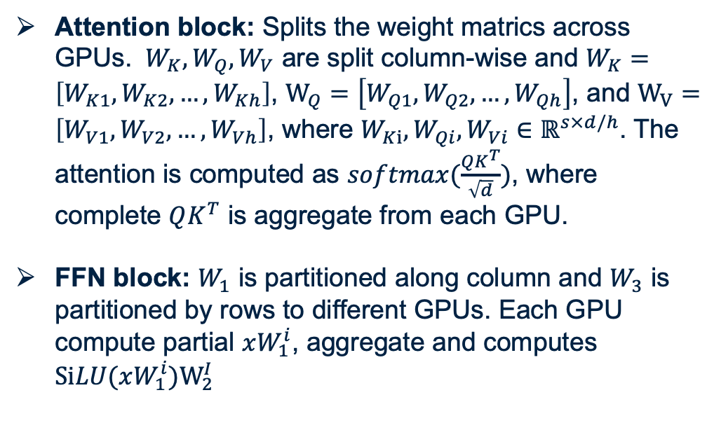
Model parallelism: tensor parallelism
Attention block: Splits the weight matrics across GPUs. $W_{K}, W_{Q}, W_{V}$ are split column-wise and $W_{K}=\left[W_{K1}, W_{K2}, …, W_{Kh}\right]$, $W_{Q}=\left[W_{Q1}, W_{Q2}, …, W_{Qh}\right]$, and $W_{V}=\left[W_{V1}, W_{V2}, …, W_{Vh}\right]$, where $W_{Ki}, W_{Qi}, W_{Vi}∈ℝ^{s×d/h}$. The attention is computed as $softmax(\frac{QK^{T}}{\sqrt{d}})$, where complete $QK^{T}$ is aggregate from each GPU.
FFN block: $W_{1}$ is partitioned along column and $W_{3}$ is partitioned by rows to different GPUs. Each GPU compute partial $xW_{1}^{i}$, aggregate and computes $SiLU(xW_{1}^{i})W_{2}^{I}$
Notes:
Review attention机制

Slide 16
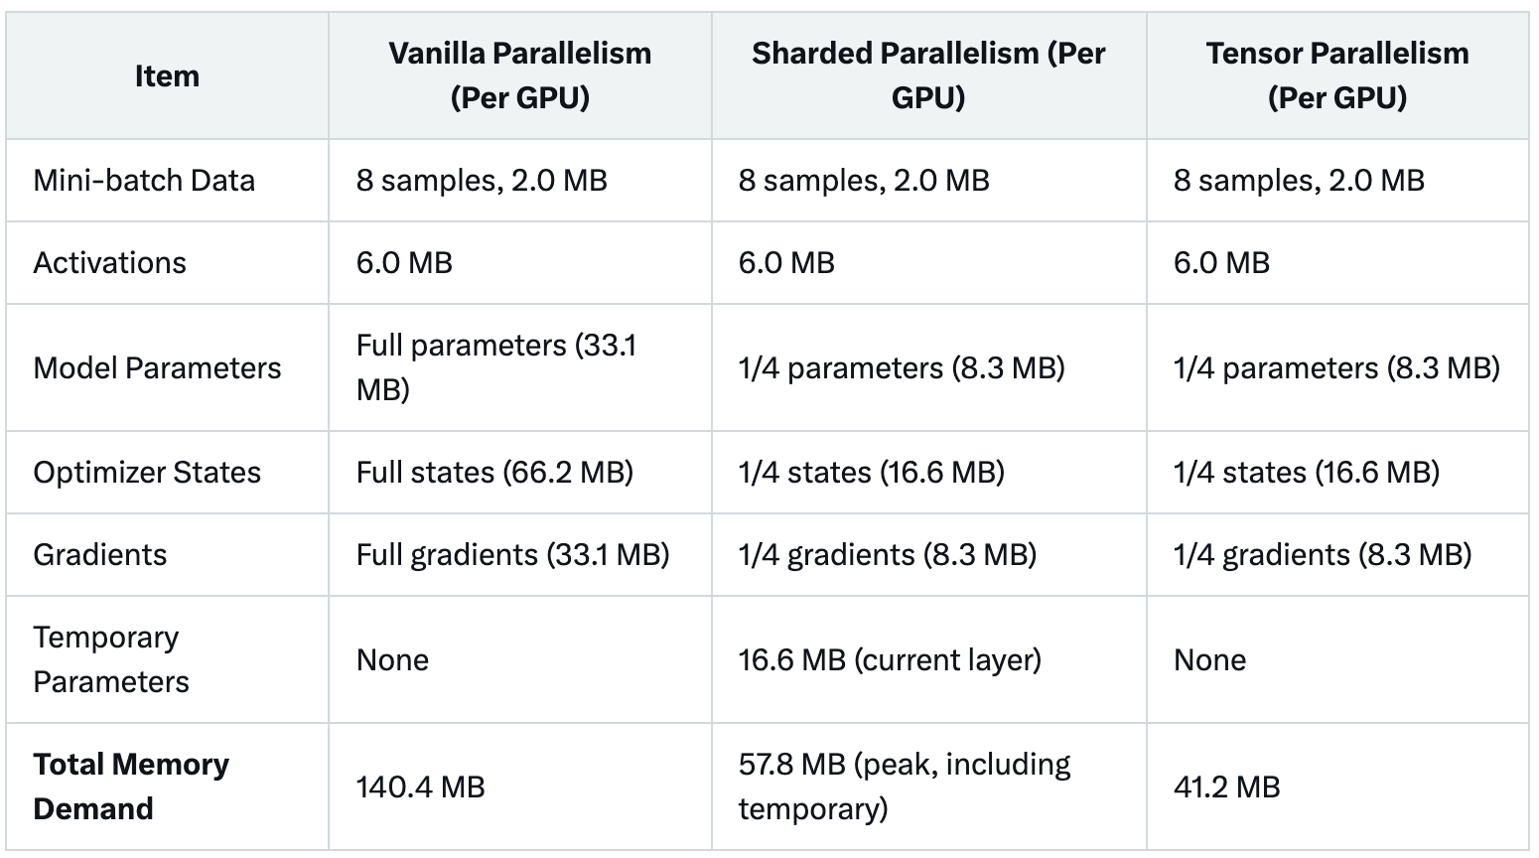
Data parallelism vs. tensor parallelism
Model parameter: 2-layer Transformer (embedding + 2 transformer + output layer) with 16,554,768 parameters (size 33.1 MB).
Memory Allocation Comparison: Vanilla, Sharded, and Tensor Parallelism (16.5M Parameters, 4 GPUs)

Slide 17
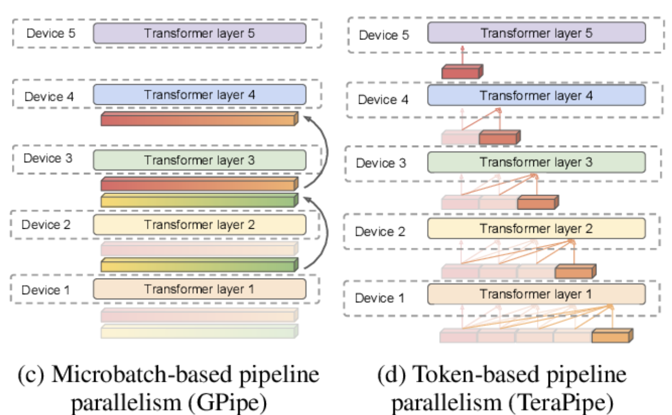
Pipeline Parallelism
Pipeline parallelism splits transformer layers across devices to form a pipeline. Each device processes a subset of layers, passing outputs to the next device.
Microbatch-based (GPipe) Splits data into microbatches, each device processes one microbatch at a time.
The sequential flow can lead to idle time (pipeline bubbles).
Figure (c) is from Reference: optimizing distributed training on Frontier for Large Language Model

Slide 18
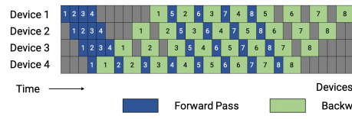
Pipeline parallelism: Understanding Pipeline Bubbles
What are Pipeline Bubbles?
Pipeline bubbles are idle periods in the pipeline where devices wait for data, reducing overall efficiency.
They occur during the startup and wind-down phases of the pipeline, as devices wait for the first microbatch to propagate or the last microbatch to complete.
Backward Pass

Slide 19
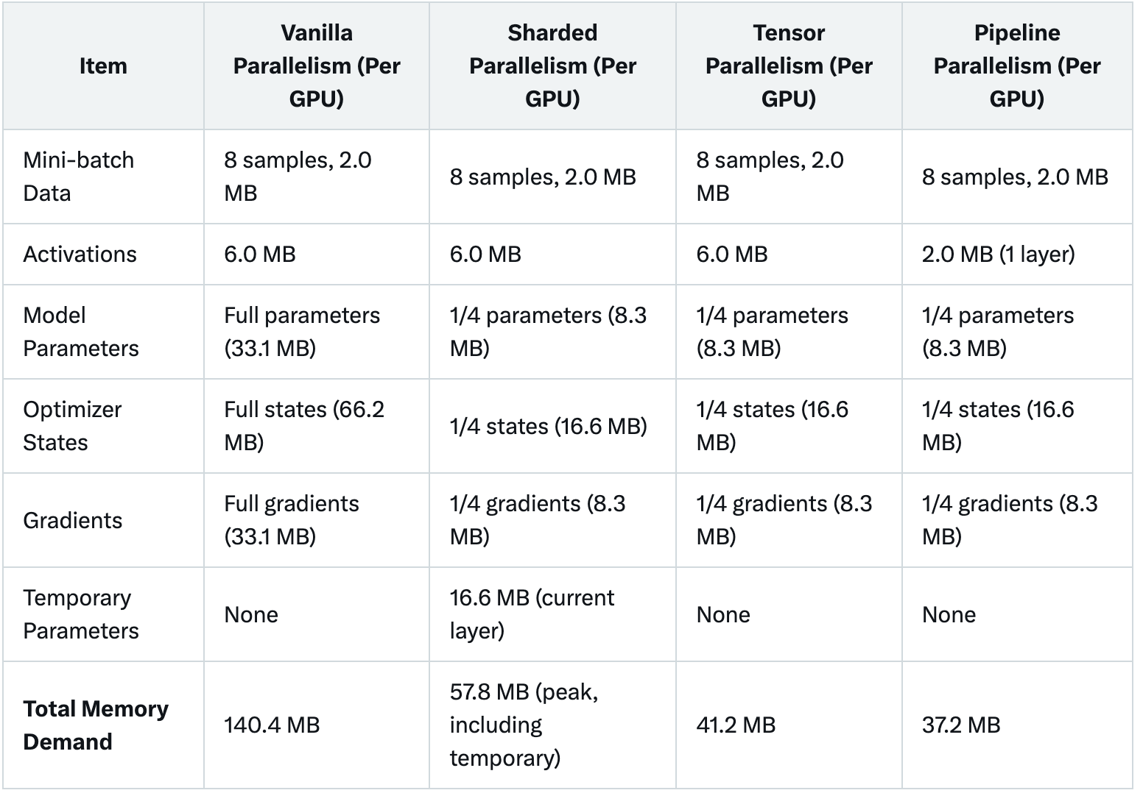
Memory allocation comparision
Model parameter: 2-layer Transformer (embedding + 2 transformer + output layer) with 16,554,768 parameters (size 33.1 MB).
Memory Allocation Comparison : Vanilla, Sharded, Tensor, and Pipeline Parallelism(16.5M Parameters, 4 GPUs)

Slide 20
Comparison of different parallelism methods
Data Parallelism (Vanilla): High memory usage, not scalable for large models, communication bottleneck.
Data Parallelism (Sharded): High communication, complex implementation, latency-sensitive.
Model Parallelism (Tensor): High communication, complex tensor splitting, computation overhead.
Pipeline Parallelism: Pipeline bubbles, complex scheduling.
Notes:
Communication bottleneck
通信时间可能超过计算时间，导致GPU空闲（等待通信完成），降低训练效率。
latency-sensitive（对延迟敏感）：
含义：由于Sharded Data Parallelism需要频繁通信（例如每个层需要All-Gather），网络延迟（latency）会显著影响性能。
computation overhead
计算开销可能抵消并行带来的加速效果，降低整体效率。

Slide 21
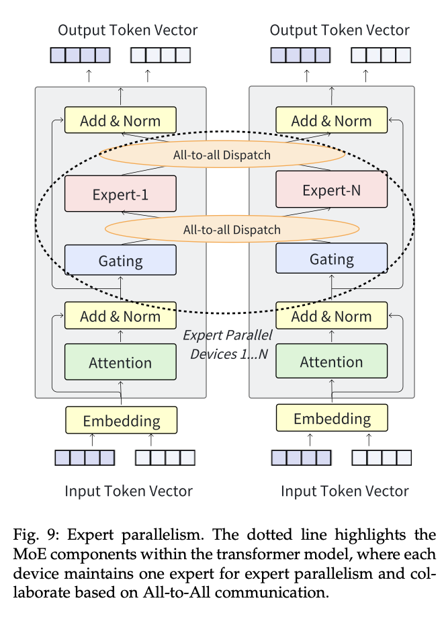
Model parallelism: Expert parallelism
Expert Parallelism is a distributed training strategy designed for Mixture-of-Experts (MoE) models.
MoE Model Structure
The Feed-Forward Network (FFN) block in a Transformer layer is replaced with an MoE layer.
The MoE layer contains multiple “experts,” each being a small FFN subnetwork.
Reference: Fig 9 of Efficient Training of Large Language Models on Distributed Infrastructures: A Survey

Slide 22
Expert parallelism
Role of Expert Parallelism
MoE Layer: Replaces the FFN in Transformers, containing multiple experts.
Gating: Selects 1-2 experts per token.
Token Dispatching: Uses All-to-All communication to send tokens to devices hosting their assigned experts.
Expert Computation: Devices process tokens using local experts.
Result Collection: Collects results via All-to-All communication.
Output Aggregation: Combines expert outputs (weighted by gating scores) for the next layer.

Slide 23
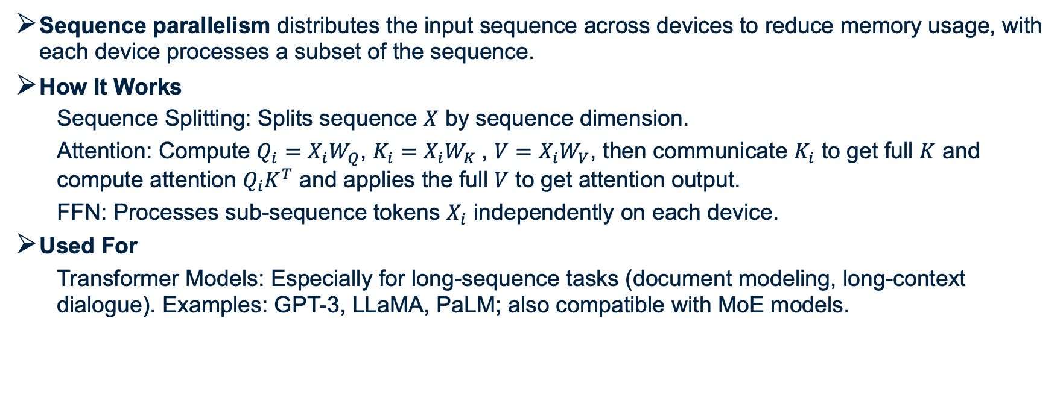
Sequence parallelism
Sequence parallelism distributes the input sequence across devices to reduce memory usage, with each device processes a subset of the sequence.
How It Works
Sequence Splitting: Splits sequence $X$ by sequence dimension.
Attention: Compute $Q_{i}=X_{i}W_{Q}$, $K_{i}=X_{i}W_{K}$, $V=X_{i}W_{V}$, then communicate $K_{i}$ to get full $K$ and compute attention $Q_{i}K^{T}$ and applies the full $V$ to get attention output.
FFN: Processes sub-sequence tokens $X_{i}$ independently on each device.
Used For
Transformer Models: Especially for long-sequence tasks (document modeling, long-context dialogue). Examples: GPT-3, LLaMA, PaLM; also compatible with MoE models.

Slide 24
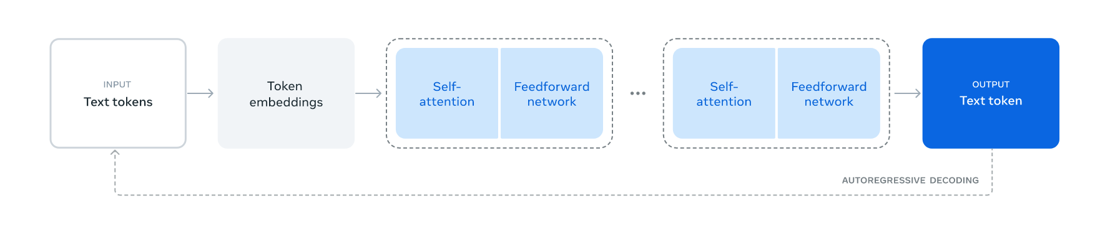
Llama 3 – Dense Transformer Distributed Training
Llama 3 Overview
Dense Transformer architecture: 405B parameters, 126 layers, 128 attention heads.
Uniform computation: Processes all tokens with full model capacity.
Challenge: Scalable training for long sequences and multimodal tasks.
Figure: Illustration of the overall architecture and training of Llama 3
Reference: Llama Team, AI @ Meta. (2024). The Llama 3 Herd of Models.
Notes:
Llama 3 is a dense transformer with 405 billion parameters, 126 layers, and 128 attention heads.
Llama 3 processes all tokens with the full model capacity. Unlike sparse models, which activate only a subset of parameters for each token, Llama 3 applies its entire computational power to every token. This ensures maximum context understanding but comes at a large computational cost.
The key challenge, is scalable training for long sequences and multimodal tasks.
This diagram gives us a high-level view of how Llama 3 transforms input tokens into output tokens, layer by layer, in an autoregressive manner. But the scale of this process—405 billion parameters across 126 layers—makes distributed training essential, which we’ll explore in the next slides.

Slide 25
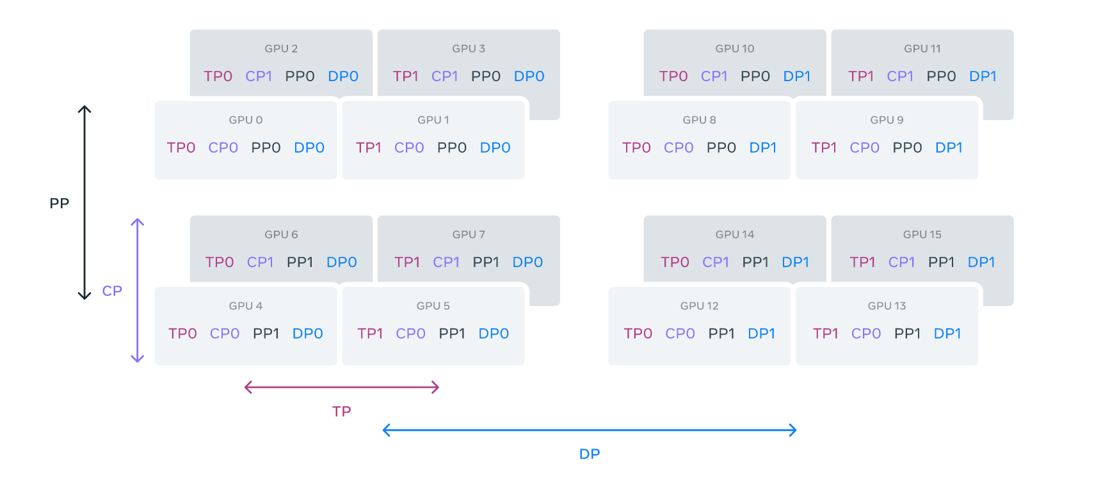
Llama 3 - Distributed Strategy: 4D Parallelism
Tensor Parallelism (TP): Splits weights across GPUs to lower memory use.
Context Parallelism (CP): Divides sequences across GPUs for long contexts.
Pipeline Parallelism (PP): Splits layers into stages for pipelined processing.
Data Parallelism (DP): Distributes data and shards models for scalable training.
Figure: Illustration of 4D parallelism
Notes:
Llama 3 employs a strategy called 4D parallelism, which combines four different types of parallelism to distribute the workload across thousands of GPUs efficiently.

Slide 26
Llama 3 - Distributed Strategy: Tensor Parallelism
Foundation: Tensor Parallelism (Megatron-LM (2019))
Splitting attention (Q, K, V) and feedforward (W₁, W₂) weight tensors across GPUs to reduce memory usage.
Training Setup:
Applied on 16K H100 GPUs with a TP degree of 8.
Each GPU handles 1/8 of weight tensors (e.g., 16 attention heads per GPU out of 128).
Notes:
instead of a single GPU trying to hold and compute with these massive tensors, the workload is divided, significantly reducing the memory burden on each GPU.

Slide 27
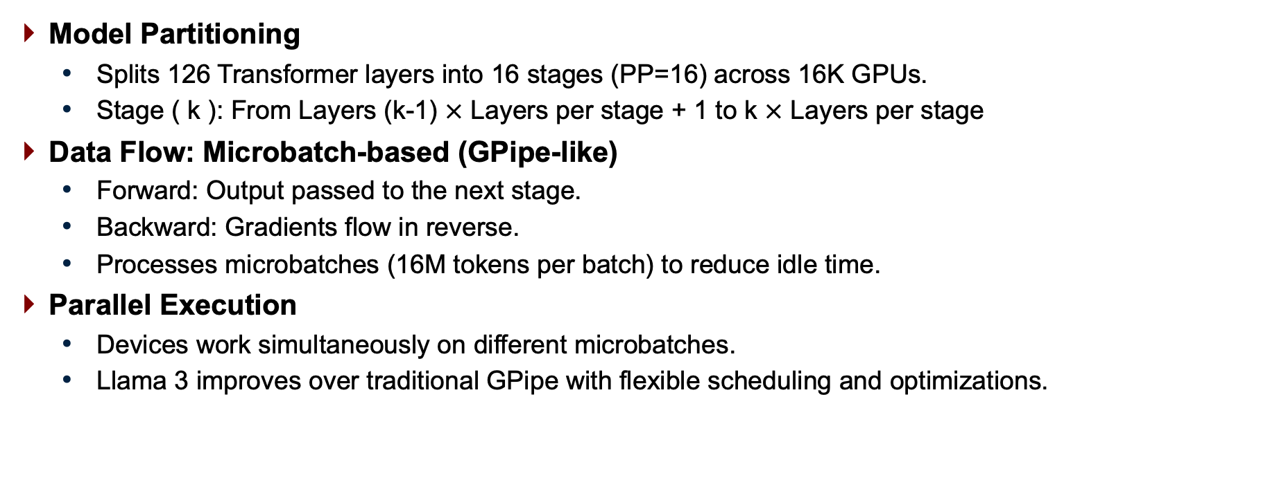
Llama 3 - Distributed Strategy: Pipeline Parallelism
Model Partitioning
Splits 126 Transformer layers into 16 stages (PP=16) across 16K GPUs.
Stage ( k ): From Layers (k-1) $×$ Layers per stage + 1 to k $×$ Layers per stage
Data Flow: Microbatch-based (GPipe-like)
Forward: Output passed to the next stage.
Backward: Gradients flow in reverse.
Processes microbatches (16M tokens per batch) to reduce idle time.
Parallel Execution
Devices work simultaneously on different microbatches.
Llama 3 improves over traditional GPipe with flexible scheduling and optimizations.
Notes:
In the forward pass, outputs are passed to the next stage, while in the backward pass, gradients flow in reverse. To reduce idle time, Llama 3 processes microbatches—each containing 16M tokens per batch—allowing stages to work in parallel and maximize GPU utilization.

Slide 28
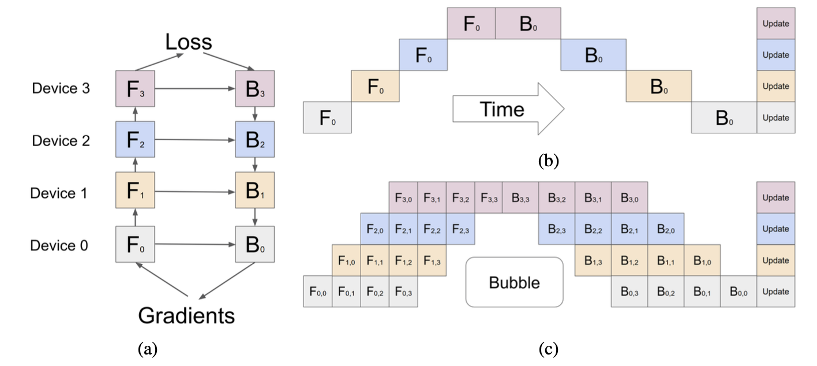
Llama 3 - Distributed Strategy: Pipeline Parallelism
Figure: Pipeline parallelism example [Huang et al., 2019]
Reference: Huang et al., Gpipe: Efficient training of giant neural networks using pipeline parallelism, 2019.
Notes:
(a) example neural network with sequential layers is partitioned across four accelerators.
Fk is the composite forward computation function of the k-th cell. Bk is the back-propagation function, which depends on both Bk+1 from the upper layer and Fk .
(b) The naive model parallelism strategy leads to severe under-utilization due to the sequential dependency of the network.
(c) Pipeline parallelism divides the input mini-batch into smaller micro-batches, enabling different accelerators to work on different micro-batches simultaneously. Gradients are applied synchronously at the end.

Slide 29
Llama 3 - Challenges with Traditional Pipeline Parallelism
Batch Size Constraint
Problem: In traditional GPipe, batch size per GPU is tied to stages (PP) or the total microbatches.
DFS: N (batch size of each stage) = PP (pipeline stages).
BFS: N = M (total microbatches).
Impact: Limits flexibility in pre-training batch adjustments for Llama 3.
Memory Imbalance
Problem: Uneven memory usage across 16 pipeline stages (126 layers).
First stage uses more memory (embedding layer).
Impact: Memory overflow on some GPUs, underuse on others.
Computation Imbalance
Problem: Last stage bottlenecks (output/loss computation).
Impact: Slows pipeline, reduces throughput.
Notes:
In traditional GPipe, the number of microbatches each stage processes, denoted as ( N ), is rigidly tied to either the number of pipeline stages, ( PP ), or the total microbatches, ( M ). For Llama 3, with PP=16, a depth-first schedule (DFS) forces ( N ) to be 16, meaning each stage must process 16 microbatches before moving forward. Alternatively, a breadth-first schedule (BFS) sets ( N ) equal to the total microbatches, ( M ). This rigidity limits flexibility in adjusting batch sizes for pre-training.
Next, there’s memory imbalance. Across Llama 3’s 16 pipeline stages, spanning 126 layers, memory usage is uneven. The first stage, which includes the embedding layer, consumes significantly more memory. This can cause memory overflow on some GPUs, while others, like those in later stages, remain underutilized, wasting resources and reducing efficiency.

Slide 30
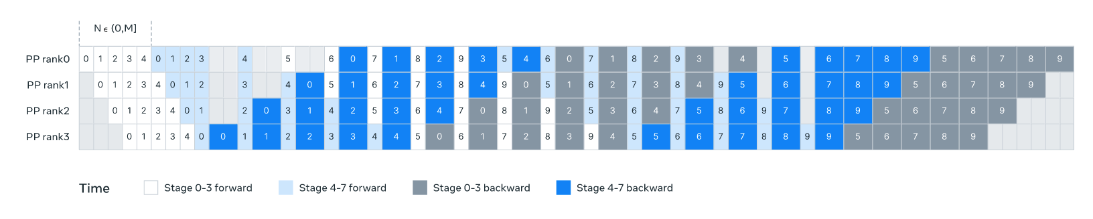
Llama 3 - Solutions
Flexible N Configuration
Solution: N set flexibly (e.g., N=5).
Benefits: Supports smaller batches, hides communication latency.
How: Balances depth-first schedule (DFS) and breadth first schedule (BFS), optimizes memory & communication.
Balancing Pipeline Load
Solution: Remove one Transformer layer from first/last stages.
First: Embedding only; Last: Output/loss only.
Result: Evenly distributes memory & computation.
Figure: Illustration of pipeline parallelism in Llama 3.
Notes:
The figure illustrates this optimized schedule. It shows 8 stages (0 to 7) across 4 pipeline ranks, with rank 0 handling stages 0 and 4, rank 1 handling stages 1 and 5, and so on. The colored blocks represent 10 micro-batches. Each rank processes 5 continuous micro-batches per stage, like micro-batches 0 to 4 in stage 0, then stage 4, Grey area without any number is bubble time, reducing idle time and balancing the load. This approach scales to Llama 3’s 16 stages, boosting efficiency

Slide 31
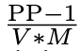
Llama 3 - Solutions
Reducing Pipeline Bubbles
Background: Bubbles cause GPU idle time.
Solution: Interleaved schedule, bubble ratio: (V: pipeline stages on one pipeline rank) [Narayanan et al., 2021].
Benefit: Larger V and M reduce bubbles, boost utilization.
Asynchronous Communication
Solution: Asynchronous point-to-point communication.
Benefits: Speeds training, hides latency, cuts memory overhead.
Memory Optimization
Solution: Proactively deallocate unused tensors (e.g., intermediate activations and temporary buffers).
Benefit: Enables 8K-token training without checkpointing.
Notes:
Llama 3 adopts an interleaved schedule, as seen in Slide 9’s diagram, assigning ( V ) pipeline stages to each pipeline rank to minimize bubbles. In Slide 9, with PP=8, V = 2 M=10,

Slide 32
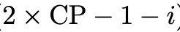
Llama 3 - Distributed Strategy: Context Parallelism
Sequence Splitting
Input (e.g., 128K tokens) divided into 2 x CP chunks.
Each GPU ( i ) gets chunk ( i ) and chunk ( ).
Implementation: All-Gather Based CP
First, all-gather Key (K) and Value (V) tensors.
Then, compute attention for local Query (Q) chunk.
Leverages GQA(Grouped-Query Attention) (8 K/V heads) to reduce communication cost [Ainslie et al., 2023].
Advantages
Flexible Attention Masks: Easily supports diverse masks (e.g., document mask).
Low communication overhead: the latency caused by all-gather operations is minimal.

Slide 33
Llama 3 - Distributed Strategy: Fully Sharded Data Parallelism
SDP (Sharded Data Parallelism):
Foundation of ZeRO (Rajbhandari et al., 2020).
Partitions optimizer states, gradients, and parameters across GPUs.
Llama 3 Implementation – FSDP (Fully Sharded Data Parallelism):
Fully shards model parameters, gradients, and optimizer states across 16K H100 GPUs.
Uses asynchronous prefetching to fetch sharded weights, reducing network latency in multi-hop setups [Ren et al., 2021].
Avoids extra all-gather operations during backward passes by skipping resharding after forward computation.
Employs Reduce-Scatter for gradient updates, ensuring efficient synchronization.
FSDP lays the foundation for integrating image, video, and speech capabilities.

Slide 34
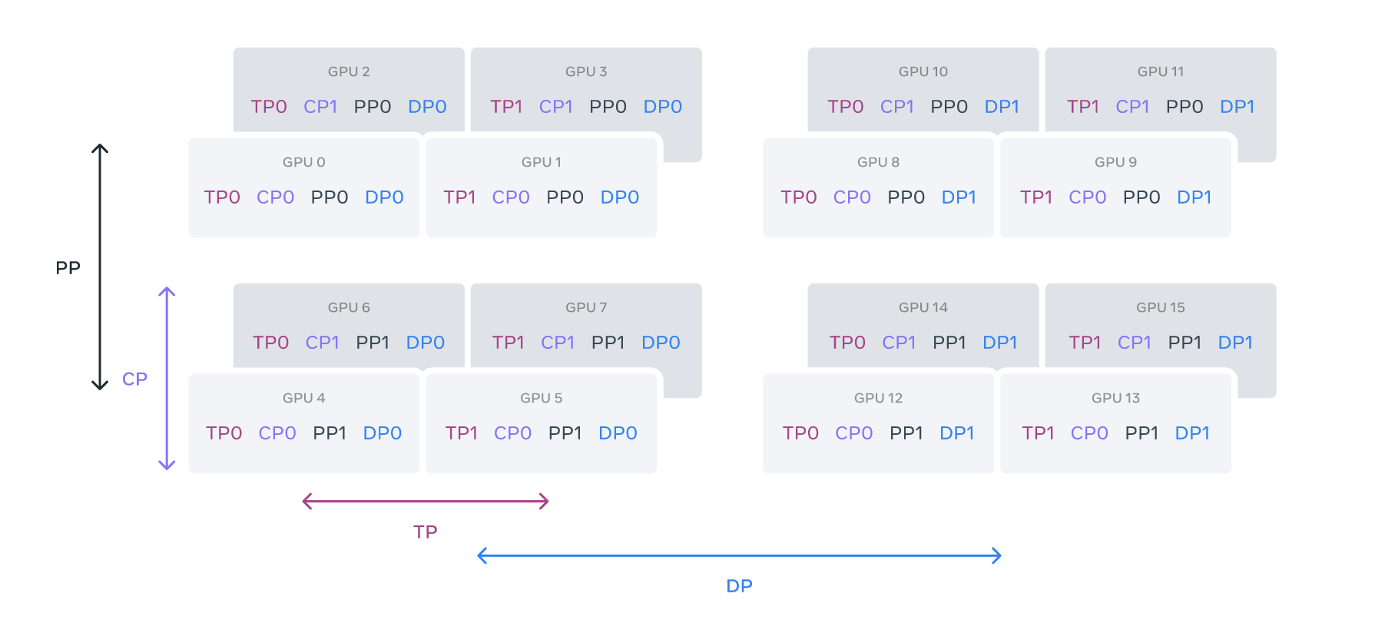
Llama 3 - Optimizing Parallelism for Network Efficiency
Parallelism Order: [TP, CP, PP, DP]
TP (Tensor Parallelism): Innermost, needs high bandwidth, low latency → within same server.
CP (Context Parallelism): Splits sequences, moderate network demand.
PP (Pipeline Parallelism): Splits layers, spans servers.
DP (Data Parallelism): Outermost, tolerates high latency → multi-hop network.
Figure: Illustration of 4D parallelism
Notes:
GPUs are divided into parallelism groups in the order of [TP, CP, PP, DP], where DP stands for FSDP. In this example, 16 GPUs are configured with a group size of |TP|=2, |CP|=2, |PP|=2, and |DP|=2. A GPU’s position in 4D parallelism is represented as a vector, [D1, D2, D3, D4], where Di is the index on the i-th parallelism dimension. In this example, GPU0[TP0, CP0, PP0, DP0] and GPU1[TP1, CP0, PP0, DP0] are in the same TP group, GPU0 and GPU2 are in the same CP group, GPU0 and GPU4 are in the same PP group, and GPU0 and GPU8 are in the same DP group

Slide 35
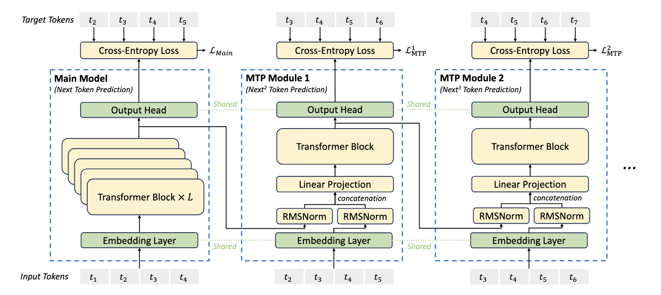
Deepseek V3 - Mixture-of-Experts (MoE) Distributed Training
DeepSeek-V3 Overview
MoE architecture: 671B total parameters, 37B activated per token (comparison: Llama 3 uses dense model with all 405B parameters activated per token).
Sparse activation: Tokens routed to subset of experts, reducing compute demand.
Challenge: Efficient distributed training across nodes.
Figure: Illustration of MoE architecture
Reference: DeepSeek-AI (2024). DeepSeek-V3 Technical Report.
Notes:
DeepSeek-V3 is an MoE model with an impressive 671 billion total parameters, but only 37 billion are activated for each token. This sparsity is a game-changer: by routing each token to a subset of experts, DeepSeek-V3 reduces the computational demand by a factor of 18 compared to a dense model of the same size. For example, while a dense model like Llama 3 uses all 405 billion parameters per token, DeepSeek-V3’s sparse approach makes training and inference far more efficient, contributing to its low training cost of just 2.788 million H800 GPU hours.
However, this sparsity introduces a key challenge: efficient distributed training across nodes. In an MoE model, tokens need to be routed to experts that may reside on different nodes, requiring cross-node communication. This can be costly due to the lower bandwidth and higher latency of inter-node networksDeepSeek-V3 tackles this with several optimizations: node-limited routing to minimize communication, computation-communication overlap to hide latency, and an auxiliary-loss-free load balancing strategy to ensure even expert utilization across nodes—preventing bottlenecks and eliminating token dropping.
The figure illustrates this MoE architecture. It shows input tokens passing through transformer blocks, with shared and routed experts handling sparse computations.

Slide 36
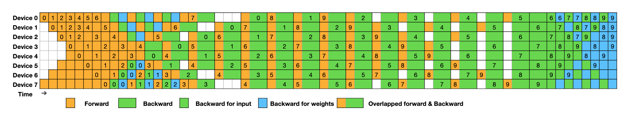
Deepseek V3 - DualPipe Algorithm
How DualPipe Works
Bidirectional Scheduling:
Alternates forward and backward passes in two directions (micro-batches 0-9 forward, 10-19 backward).
Reduces pipeline bubbles by overlapping micro-batches.
Computation-Communication Overlap:
Hides all-to-all communication (e.g., MoE experts) during computation.
Achieves near-zero communication overhead.
Figure: Example of DualPipe scheduling for 8 PP ranks and 20 micro-batches in two directions.
Notes:
Figure 5 | Example DualPipe scheduling for 8 PP ranks and 20 micro-batches in two directions. : at Time 0, Device 0 processes micro-batch 0 forward, while Device 7 handles micro-batch 19 backward. By Time 2, all devices are busy—Device 0 on micro-batch 2 forward, Device 7 on micro-batch 17 backward—leaving almost no idle time, as you can see with the minimal white spaces.
Two cells enclosed by a shared black border have mutually overlapped computation and communication.

Slide 37
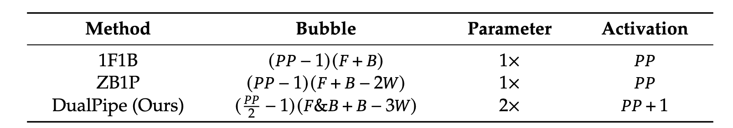
Deepseek V3 - DualPipe Algorithm
Efficiency Analysis
Fewer Bubbles: DualPipe reduces bubble time to .
Memory Usage: 2x parameters, PP+1activations, balanced across devices.
Impact in DeepSeek-V3
Scalability: Enables efficient MoE training across nodes, supporting 671B parameters.
Cost-Effective: Contributes to low training cost (2.788M H800 GPU hours, $5.576M).
Stability: No loss spikes or rollbacks during training.
Table: Comparison of pipeline bubbles and memory usage across different pipeline parallel methods.
F denotes the execution time of a forward chunk, B denotes the execution time of a full backward chunk, W denotes the execution time of a "backward for weights" chunk, and F&B denotes the execution time of two mutually overlapped forward and backward chunks.
Notes:
Now, let’s talk about memory usage. DualPipe requires 2× the model parameters and PP+1
activations, which might sound like a trade-off at first. But this design choice allows us to balance memory across devices efficiently, supporting the massive scale of DeepSeek-V3 while maintaining stability.

Slide 38
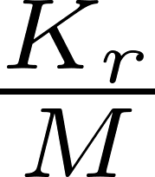

Deepseek V3 - Node-Limited Routing
Strategy
Limits each token to M nodes.
Routes based on top affinity scores per node ( = activated experts).
Benefits
Reduces cross-node communication.
Achieves near-full computation-communication overlap.
Implementation
Avoids global all-to-all overhead using InfiniBand & NVLink.

Slide 39
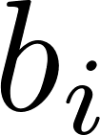
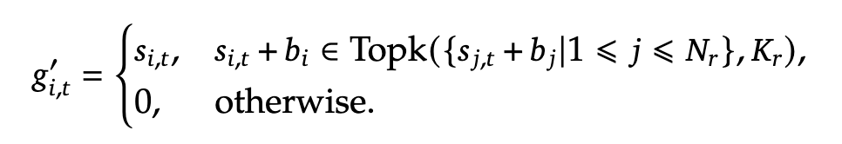

Deepseek V3 - Auxiliary-Loss-Free Load Balancing
Strategy
Balances expert load with dynamic bias term ( ) .
Add bias term to affinity score to determine the top-K routing (gating value of i-th expert, t-th token):
Adjusts per step: ↓ by if overloaded, ↑ if underloaded.
Benefits
No performance hit vs. traditional auxiliary loss (e.g., GShard).
No token dropping, boosting efficiency.

Slide 40
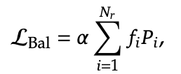
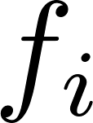


Deepseek V3 - Complementary Sequence-Wise Auxiliary Loss
Strategy
Adds small sequence-wise loss to the total loss:
: expert load, : normalized affinity, : tiny factor.
Role
Prevents extreme imbalance within sequences.
Supports primary load balancing approach.

Slide 41
Deepseek V3 - Cross-Node Communication Optimization
Goal
Leverage cluster hardware (e.g., 2048 H800 GPUs) efficiently.
Efficient All-to-All Kernels
Custom kernels for cross-node communication.
Maximizes InfiniBand & NVLink bandwidth.
Reduces latency in MoE expert data exchange.
Memory Footprint Optimization
Carefully tuned memory usage.
Avoids costly tensor parallelism.
Enables scalable training across more nodes without efficiency loss.

Slide 42
From High-end Clusters to Consumer-Grade Networks
LLM Networks
High-end clusters: Expensive, limited access (e.g., 16K H100 GPUs for Llama 3).
Consumer-grade networks: Low bandwidth (100 Mbit/s), high latency (100 ms RTT), unreliable.
Goal
Run large language models over consumer-grade networks.
Challenges
Network unreliability: Nodes may disconnect anytime.
Limited bandwidth & high latency: Slows down communication.
Heterogeneous devices: Varying compute capabilities.
PETALS (Peer-to-Peer Efficient Training and Learning System) [Borzunov et al., 2023]
Notes:
Now, I have gone through the distributed strategies of Llama 3 and DeepSeek, two of the most innovative large language models currently. However, they were both trained and evaluated on high-end clusters, which are expensive and limit access for normal users. I also need to consider how they can be applied in everyday life, specifically on consumer-grade networks.

Slide 43
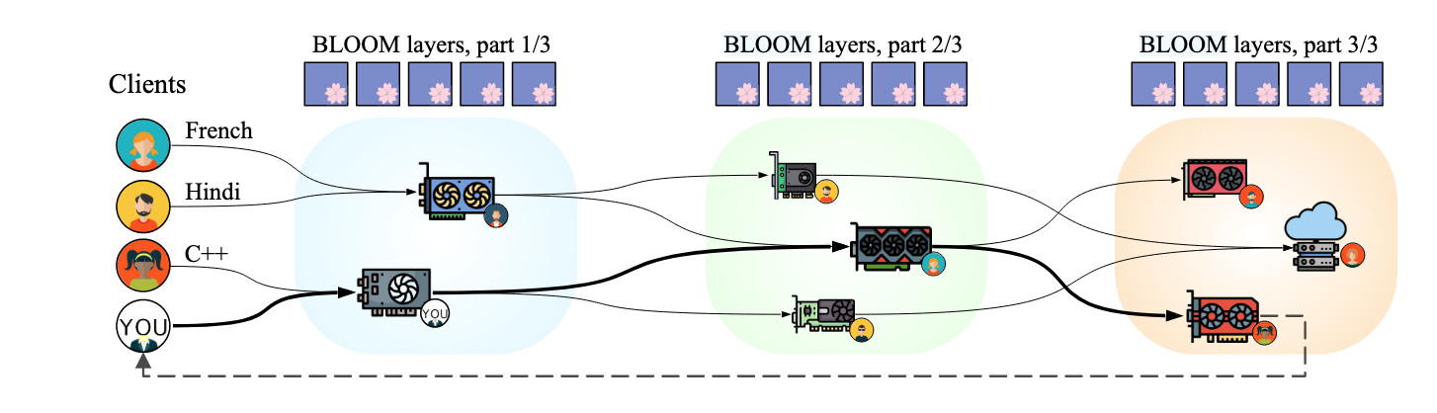
PETALS: Run LLMs on Consumer-Grade Networks
PETALS (Peer-to-Peer Efficient Training and Learning System) [Borzunov et al., 2023]
A decentralized system for LLMs on consumer-grade networks.
Enables efficient inference & fine-tuning with idle resources.
Figure 1: A high-level overview of PETALS.
Reference: Borzunov et al. (2023). Distributed Inference and Fine-tuning of Large Language Models Over The Internet.
Notes:
A high-level overview of our system design. Servers store pretrained LLM layers and temporarily hold attention caches for inferencing. Clients hold embedding layers and learned prompts/adapters (if used). Arrows denote temporary chains formed for inference.

Slide 44
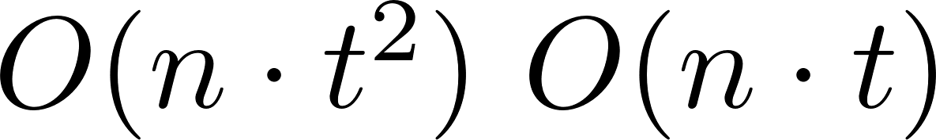
PETALS - Extending Model Parallelism for Consumer-Grade Networks
Pipeline Parallelism Foundation: Splits model into layers across devices, stage-by-stage processing.
Fault Tolerance
High-Tier: Assumes stable nodes, no failure recovery (restarts on failure).
PETALS:
Dual Attention Caches:
Server-side: Stores past attention keys/values.
Client-side: Caches inputs to pipeline stages.
Recovers from failures without recomputing all tokens, reduces communication from to .
Direct Communication:
Servers send outputs to client & next stage in parallel.

Slide 45
PETALS - Extending Model Parallelism for Consumer-Grade Networks
Dynamic Load Balancing
High-Tier: Static block assignment, struggles with node changes.
PETALS:
Servers dynamically assign model blocks to maximize throughput.
Greedy algorithm prioritizes bottleneck blocks.
Adapts to nodes joining/leaving, maintains pipeline continuity.
Communication Optimization
High-Tier: High bandwidth needs, no optimization for low-bandwidth networks.
PETALS: Dynamic Blockwise Quantization halves bandwidth (~KB per token), direct server-to-server communication with asynchronous checksums.
Notes:
Kilobyte

Slide 46
PETALS - Extending Model Parallelism for Consumer-Grade Networks
Parameter-Efficient Fine-Tuning
Clients manage trainable parameters (e.g., adapters).
Servers perform backpropagation, no parameter updates.
No caching needed, low failure recovery cost.
High Latency Adaptation
High-Tier: Assumes low-latency networks (e.g., NVLink), high latency degrades performance.
PETALS: Shortest Path Routing selects low-latency server chains.

Slide 47
PETALS Methods - Improvements on Consumer-Grade Networks
Efficient Inference
10× faster than offloading (0.34 vs. 0.0427 steps/s, 100 Mbit/s, 100 ms RTT).
Low bandwidth: Transfers only ~KB per token.
High latency: Dynamic routing mitigates 100 ms RTT impact.
Fault Tolerance
Recovers from node failures (5% failure rate still performs well).
Dynamic load balancing ensures pipeline continuity.
Low Resource Demand
Client: 8 CPU cores, no GPU needed.
Server: Runs on consumer GPUs (e.g., RTX 3090).
Notes:
Megabits per second
milliseconds Round-Trip Time

Slide 48
Thank you for your attention!

